Slide 1
ObaaS Testing

Slide 2
OBaaS on Kubernetes Cluster
1. What is ObaaS? 2. ObaaS cloud deployment 3. ObaaS components and testing approach
4. Test cases 5. Demo
6. Q/A

Slide 3
1. What is Outbound as a services?
Outbound as a Service (ObaaS) is the next generation of Proactive Outreach Manager (POM), rewritten to be compatible with cloud-native architecture.
ObaaS has two main service groups: campaign and contact, which are responsible for handling outbound tasks. It operates entirely on the cloud, in this case Microsoft Azure.

Slide 4
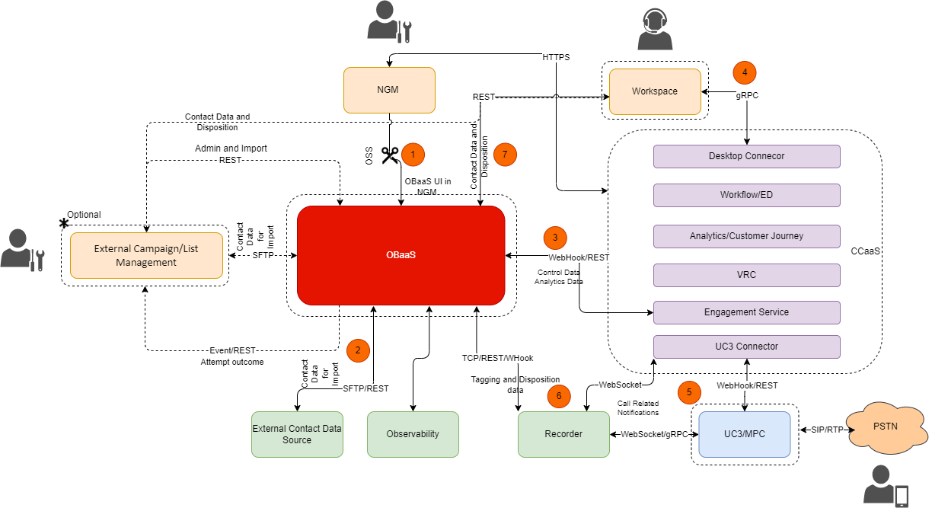
2. Solution Overview

Slide 5
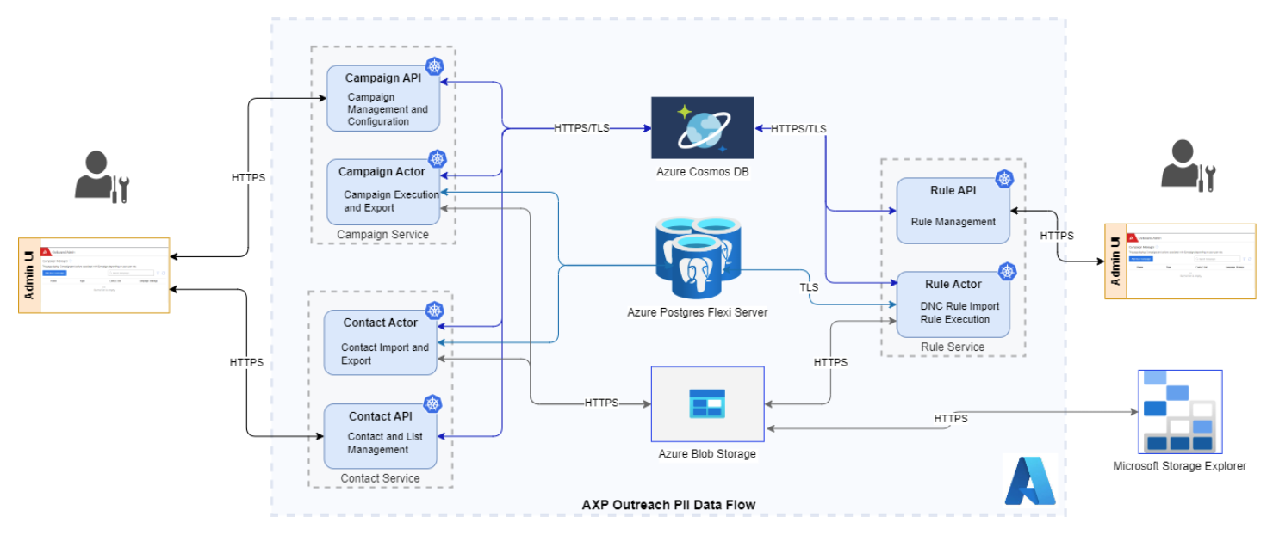
2. Data flow Diagram

Slide 6
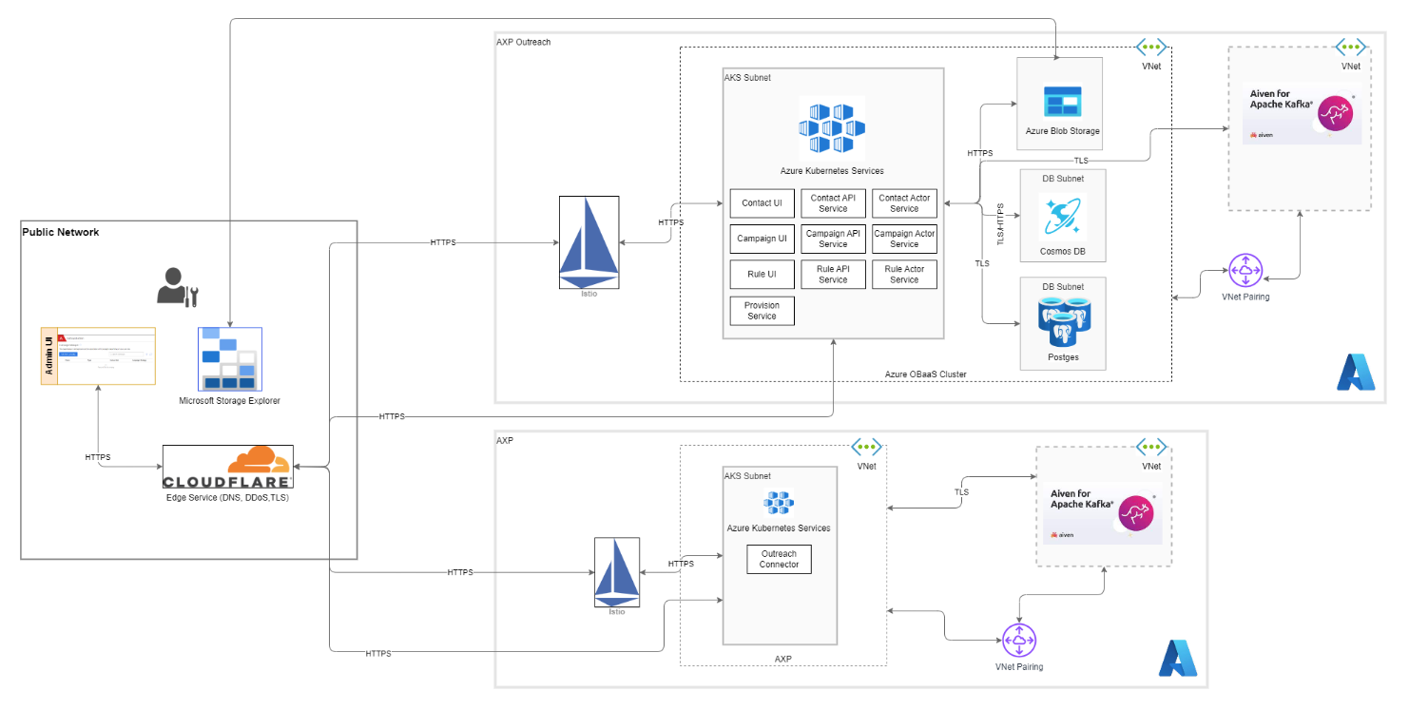
2. Network Diagram

Slide 7
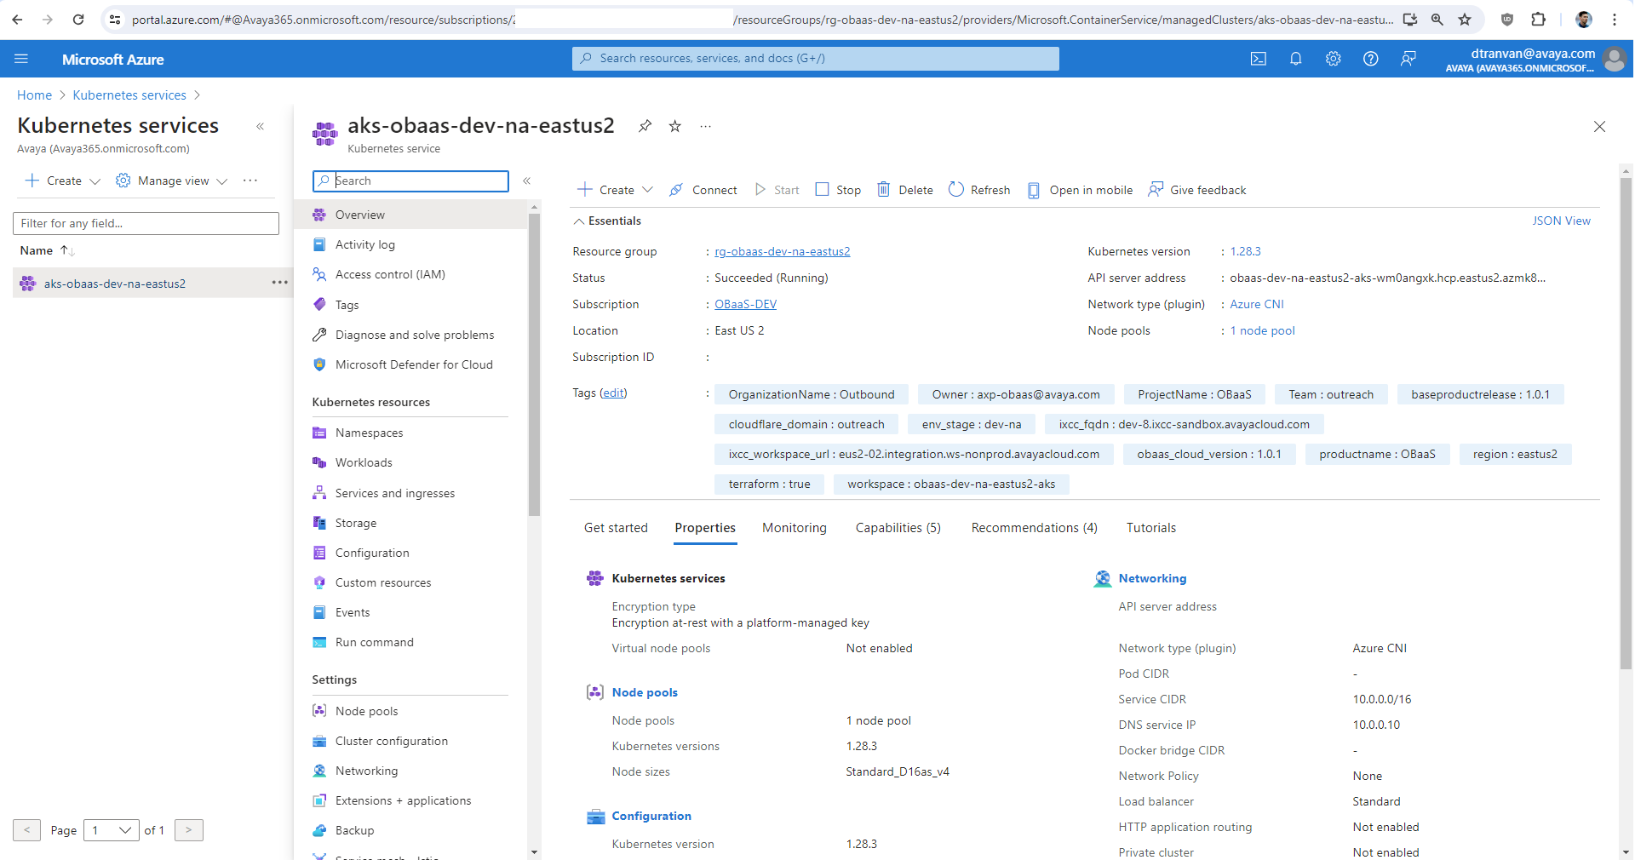
2. ObaaS cloud deployments
ObaaS is deployed on Azure with CI/CD, using a fully automated deployment solution to the Azure Kubernetes service.

Slide 8
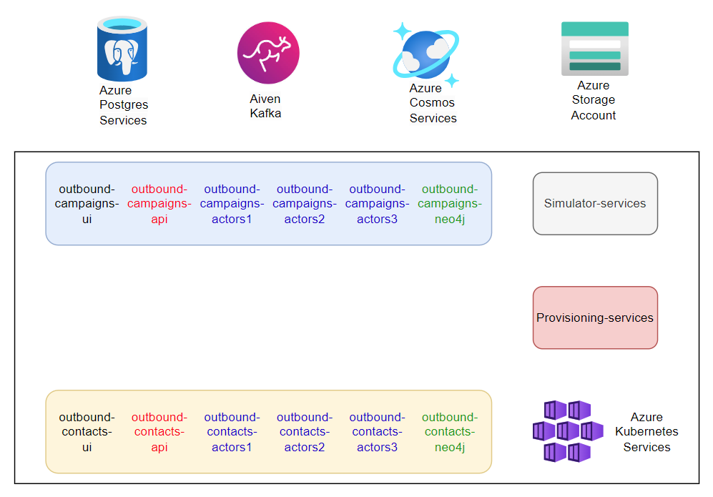
3. ObaaS components and testing approach

Slide 9
3. ObaaS components and testing approach
Components
Namespace: outbound-campaigns, outbound-contacts, outbound-provision, outbound-campaign-actors, outbound-contacts-actors,outbound-simulator
Pod group: UI, API, Actors
Horizontal Pod Autoscaling (HPA): campaign-actors, contact-actors
Notes:
https://kubernetes.io/docs/tasks/run-application/horizontal-pod-autoscale/
https://viblo.asia/p/hpa-la-gi-auto-scaling-pod-bang-hpa-va-keda-ByEZkerA5Q0

Slide 10
3. Kubernetes Components
Container Runtime
With respect to Kubernetes, A container runtime is a CRI (Container Runtime Interface) compatible application that executes and manages containers.
containerd
CRI-O
Docker Engine
Mirantis Container Runtime
Notes:
https://kubernetes.io/docs/setup/production-environment/container-runtimes/

Slide 11
3. Kubernetes Components
Networking - CNI
Networking within Kubernetes is plumbed via the Container Network Interface (CNI), an interface between a container runtime and a network implementation plugin.
Flannel: A simple, lightweight layer 3 fabric for Kubernetes. It is easy to set up and manage, and supports a variety of backend mechanisms.
Calico: A networking and network policy provider for Kubernetes. It offers advanced network administration and security capabilities.
Notes:
https://kubernetes.io/docs/concepts/cluster-administration/addons/

Slide 12
3. Kubernetes Components
Objects In Kubernetes
Kubernetes objects are persistent entities in the Kubernetes system. Kubernetes uses these entities to represent the state of your cluster. Specifically, they can describe:
What containerized applications are running (and on which nodes)
The resources available to those applications
The policies around how those applications behave, such as restart policies, upgrades, and fault-tolerance
Notes:
https://kubernetes.io/docs/concepts/overview/working-with-objects/

Slide 13
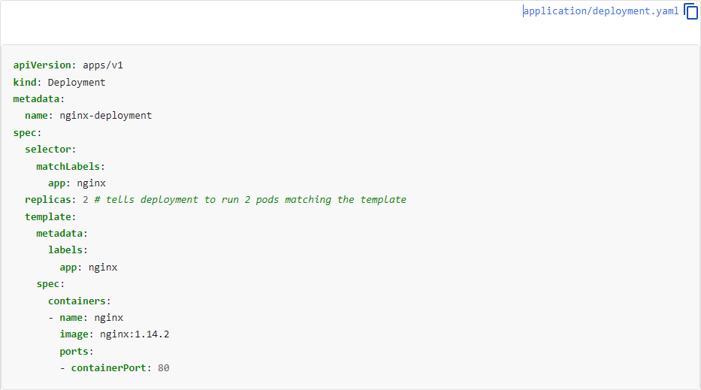
3. Kubernetes Components
Objects In Kubernetes
Notes:
https://kubernetes.io/docs/concepts/overview/working-with-objects/

Slide 14
4. Install Kubernetes on Ubuntu Server
GNU/Linux - Ubuntu server
Set hostname of Each Node
Disable swap and Add Kernel Modules
Install Containerd Runtime on All Nodes
Install Kubectl, kubelet and kubeadm on all nodes
Install Kubernetes Cluster using kubeadm
Add Worker Nodes to Kubernetes Cluster
Deploy Calico Pod Network Add-on
Test and Verify Kubernetes Cluster Installation
Notes:
https://www.linuxtechi.com/install-kubernetes-k8s-on-ubuntu-20-04/

Slide 15
5. Demo

Slide 16
6. QA

Slide 17
Microservices Testing

Slide 18
1. Types of testing with K8s
Unit Tests
Integration Tests
End-to-End (E2E) Tests
Performance or Load Tests
Notes:
https://www.linuxtechi.com/install-kubernetes-k8s-on-ubuntu-20-04/

Slide 19
2. Automation’s current problems
Monitor system resources
Verify pod status
Scale up/down pod
Notes:
https://www.linuxtechi.com/install-kubernetes-k8s-on-ubuntu-20-04/

Slide 20
3. Solve the current problem
Setup
Using BDD cucumber setup
Dependencies:
<!-- https://mvnrepository.com/artifact/io.fabric8/kubernetes-client --> <dependency> <groupId>io.fabric8</groupId> <artifactId>kubernetes-client</artifactId> <version>6.10.0</version> </dependency>
Using kubernete/azure config file to connect to K8s
Notes:
https://www.linuxtechi.com/install-kubernetes-k8s-on-ubuntu-20-04/

Slide 21
4. Automation Handle Pods/Deployments
public List<Pod> findPodDetails(String NameSpaceDetails)
→ Retrun list Pods base on Namespace
public void scalePods(String deploymentType, String deploymentDetails, String NameSpaceDetails, int NoOfReplicas)
→ Scale pods of deployment
public void restartDeployment(String deploymentType, String deploymentDetails, String NameSpaceDetails)
→ Restart all pods of deployment
public List<PodMetrics> getResourceUsed()
→ Get list ResourceUsed of Pods
Notes:
https://www.linuxtechi.com/install-kubernetes-k8s-on-ubuntu-20-04/

Slide 22
5. USER CASE
Monitor status of Pods
User can monitor status all Pods of the application
Restart Pods during application running and monitor
Verify Restart contact actor during import contact list with 1k contacts in csv
Scale up/down Pods during application running and monitor
Verify Scale contact actor during import contact list with 1k contacts in csv
Monitor resources used of application during application running
User can read resources used of pods real time
Notes:
https://www.linuxtechi.com/install-kubernetes-k8s-on-ubuntu-20-04/

Slide 23
6. Demo

Slide 24
7. QA

Slide 25
THANK YOU !

